Slide 1
DAIRY FARM LABOUR
MADE BY:ANUM AMAN 3RD YEAR MORNING

Slide 2
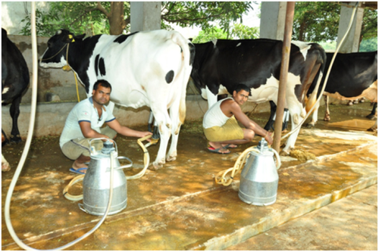
DAIRY FARM LABOUR: Dairy farm workers usually work with cows and rarely with other animals for production of milk and other related products.They are responsible for their food, shelter ,sanity and medical care.

Slide 3
TYPES OF LABOUR: 1.PERMANENT LABOUR: Workers who work for along period of time. 2.TEMPORARY LABOUR: Workers who are engaged for a specific duration of time. 3.CASUAL LABOUR: Workers who are appointed seasonally or at the time of extra work specifically.

Slide 4
DURATION OF WORKERS: 1.FULL TIME LABOUR: Workers who work for 35 to 40 hours per week. 2.PART TIME LABOUR: Labour who work for fewer hours then a full time worker in a week. 3.OVERTIME WORKERS: Workers who work for extra hours more then their appointed hours for extra wages. 4.SHIFT WORKERS: Workers who works in shifts or set period of time and get paid.

Slide 5
JOB DESCRIPTION: 1.MANAGER: A person who is responsible for controlling or administering a group of staff. 2. VET: A person who looks after medical health of animals and do medical checkups. 3.MILKER: A person who milks the cows. 4.FEEDING MAN: A person who feeds the animals time to time. 5.CLEANING MAN: A person who is responsible for cleaning of animals and farm and sanitization. 6.SECURITY GUARD: A person who takes care of security of animals and farms.

Slide 6
6.TRANSPORTER: A person who transports milk and other products to the market. TYPES OF WAGES 1.TIME WAGES: The worker is paid according to hours he works. 2.CASH WAGES: The worker is paid in terms of money. 3.PIECE WAGES: The worker is paid in terms of unit production.

